Slide 1
ESC101: Fundamentals of Computing
Search and BSTs
Nisheeth

Slide 2
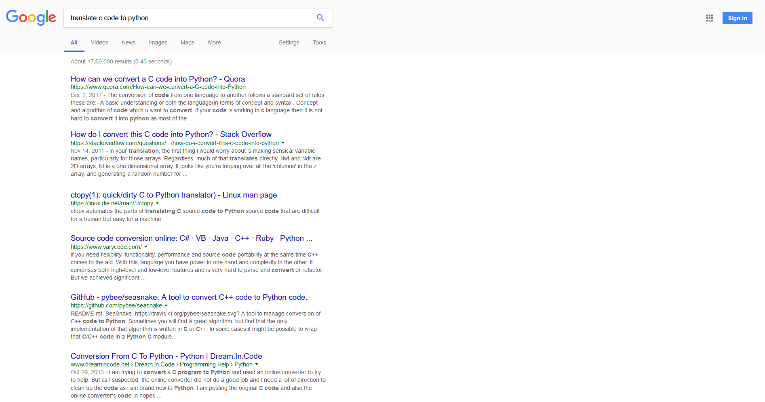
Internet Searches
Most relevant webpage
Google sorts webpages in decreasing relevance to the query you asked!
Less relevant webpage
Notes:
We consider a simpler form of search in this course. Searching for integers in arrays.

Slide 3
Brute Force Search
6
4
9
1
1
4
1
8
2
3
8
Is the element 4 present in the array?
Can search the array from left to right or right to left
for(i=0;i<11;i++) if(a[i]==4) return i; return -1;
for(i=10;i>=0;i--) if(a[i]==4) return i; return -1;
Searching from left seems faster for the query 4
Is the element 3 present in the array?
Is the element 5 present in the array?
If there are N elements in the array we have to do at least N operations (to verify absence) - can we do any better?

Slide 4
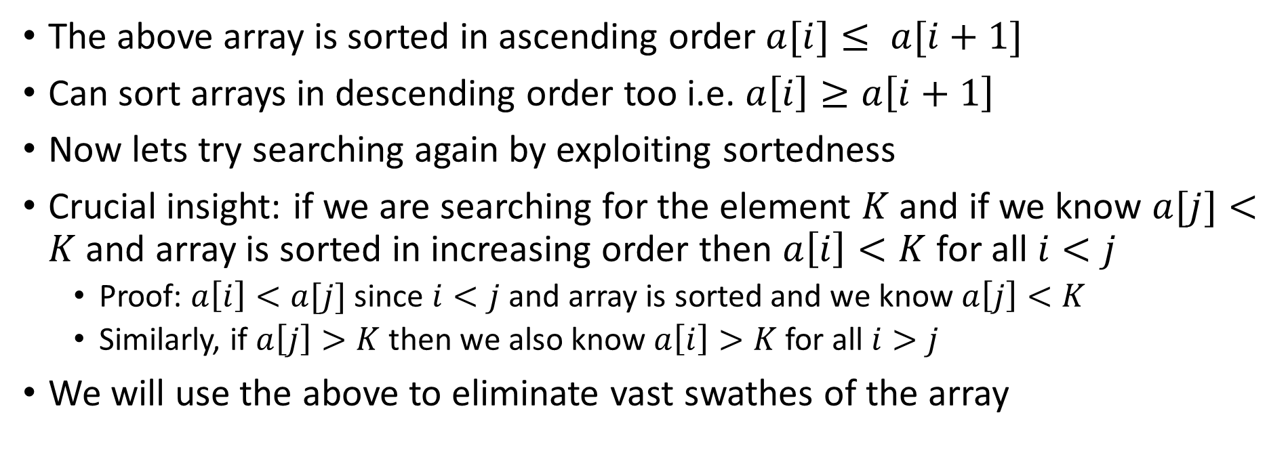
Binary Search
1
1
1
2
3
4
4
6
8
8
9
The above array is sorted in ascending order $a[i]≤ a[i+1]$
Can sort arrays in descending order too i.e. $a\left[i\right]≥a\left[i+1\right]$
Now lets try searching again by exploiting sortedness
Crucial insight: if we are searching for the element $K$ and if we know $a[j]<K$and array is sorted in increasing order then $a\left[i\right]<K$for all $i<j$
Proof: $a\left[i\right]<a[j]$ since $i<j$ and array is sorted and we know $a\left[j\right]<K$
Similarly, if $a\left[j\right]>K$then we also know $a\left[i\right]>K$for all $i>j$
We will use the above to eliminate vast swathes of the array

Slide 5
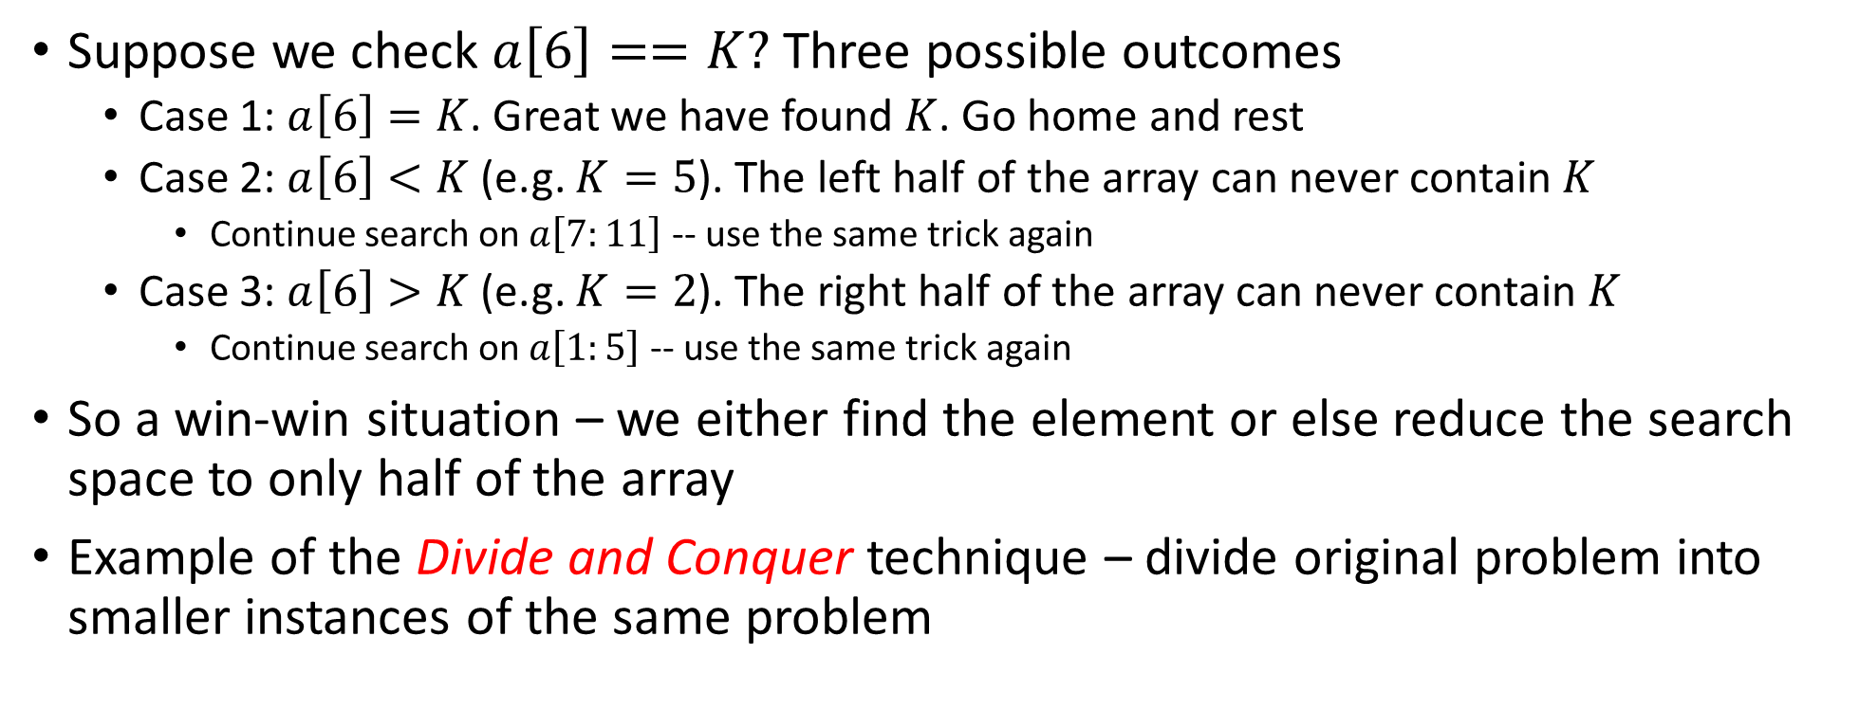
Binary Search
1
1
1
2
3
4
4
6
8
8
9
Suppose we check $a\left[6\right]==K?$ Three possible outcomes
Case 1: $a\left[6\right]=K$. Great we have found $K$. Go home and rest
Case 2: $a\left[6\right]<K$ (e.g. $K=5$). The left half of the array can never contain $K$
Continue search on $a\left[7:11\right]$ -- use the same trick again
Case 3: $a\left[6\right]>K$ (e.g. $K=2$). The right half of the array can never contain $K$
Continue search on $a\left[1:5\right]$ -- use the same trick again
So a win-win situation – we either find the element or else reduce the search space to only half of the array
Example of the Divide and Conquer technique – divide original problem into smaller instances of the same problem

Slide 6
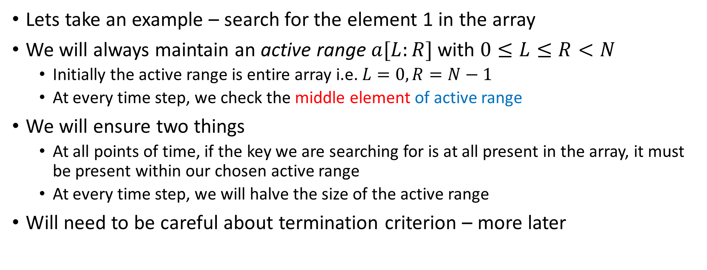
Binary Search
1
1
1
2
3
4
4
6
8
8
9
Lets take an example – search for the element 1 in the array
We will always maintain an active range $a[L:R]$ with $0≤L≤R<N$
Initially the active range is entire array i.e. $L=0,R=N−1$
At every time step, we check the middle element of active range
We will ensure two things
At all points of time, if the key we are searching for is at all present in the array, it must be present within our chosen active range
At every time step, we will halve the size of the active range
Will need to be careful about termination criterion – more later

Slide 7
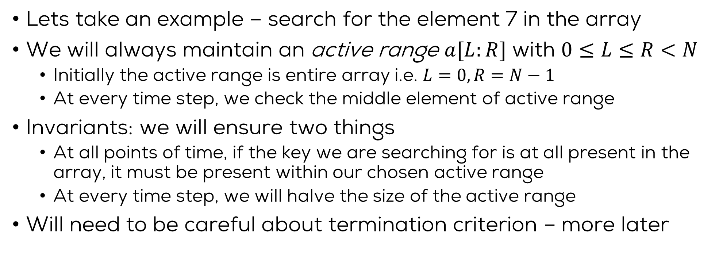
Binary Search
1
1
1
2
3
4
4
6
8
8
9
Lets take an example – search for the element 7 in the array
We will always maintain an active range $a[L:R]$ with $0≤L≤R<N$
Initially the active range is entire array i.e. $L=0,R=N−1$
At every time step, we check the middle element of active range
Invariants: we will ensure two things
At all points of time, if the key we are searching for is at all present in the array, it must be present within our chosen active range
At every time step, we will halve the size of the active range
Will need to be careful about termination criterion – more later

Slide 8
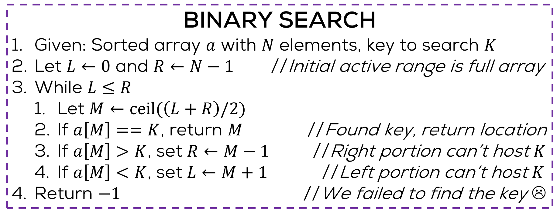
Binary Search
Exercise: write a recursive version
Exercise: convert this to proper C code
BINARY SEARCH
Given: Sorted array $a$ with $N$ elements, key to search $K$
Let $L←0$ and $R←N−1$ //Initial active range is full array
While $L≤R$
Let $M←ceil(\left(L+R\right)/2)$
If $a\left[M\right]==K$, return $M$ //Found key, return location
If $a\left[M\right]>K$, set $R←M−1$ //Right portion can’t host $K$
If $a\left[M\right]<K$, set $L←M+1$ //Left portion can’t host $K$
Return $−1$ //We failed to find the key ☹
The above is often known as pseudo code, something that gives details of an algorithm but does not strictly follow rules of C or any other programming language

Slide 9
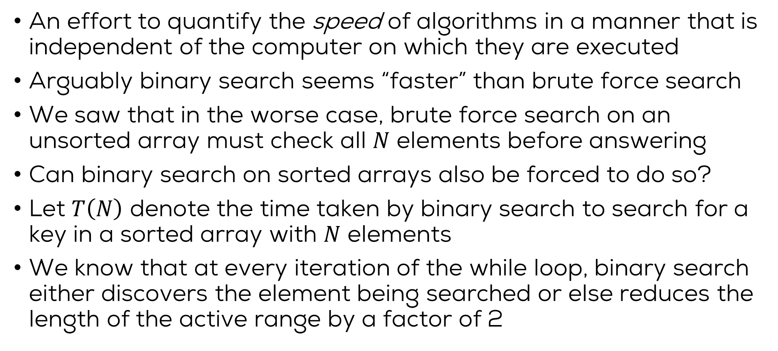
Asymptotic Time Complexity
An effort to quantify the speed of algorithms in a manner that is independent of the computer on which they are executed
Arguably binary search seems “faster” than brute force search
We saw that in the worse case, brute force search on an unsorted array must check all $N$ elements before answering
Can binary search on sorted arrays also be forced to do so?
Let $T\left(N\right)$ denote the time taken by binary search to search for a key in a sorted array with $N$ elements
We know that at every iteration of the while loop, binary search either discovers the element being searched or else reduces the length of the active range by a factor of 2

Slide 10
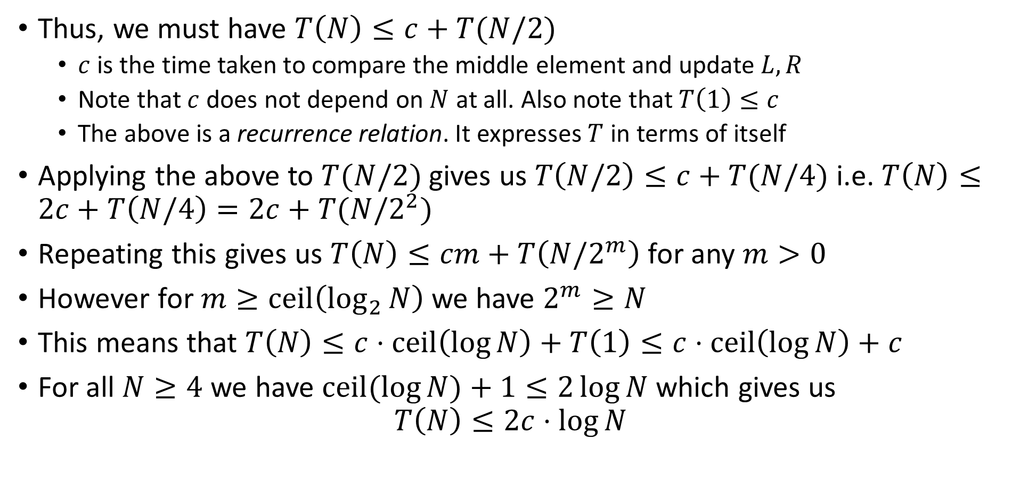
Asymptotic Time Complexity
Thus, we must have $T\left(N\right)≤c+T(N/2)$
$c$ is the time taken to compare the middle element and update $L,R$
Note that $c$ does not depend on $N$ at all. Also note that $T\left(1\right)≤c$
The above is a recurrence relation. It expresses $T$ in terms of itself
Applying the above to $T(N/2)$ gives us $T\left(N/2\right)≤c+T(N/4)$ i.e. $T\left(N\right)≤2c+T\left(N/4\right)=2c+T(N/2^{2})$
Repeating this gives us $T\left(N\right)≤cm+T\left(N/2^{m}\right)$ for any $m>0$
However for $m≥ceil\left(\log_{2}{N}\right)$ we have $2^{m}≥N$
This means that $T\left(N\right)≤c⋅ceil\left(\log{N}\right)+T\left(1\right)≤c⋅ceil\left(\log{N}\right)+c$
For all $N≥4$ we have $ceil(log{N)}+1≤2\log{N}$ which gives us $T\left(N\right)≤2c⋅\log{N}$

Slide 11
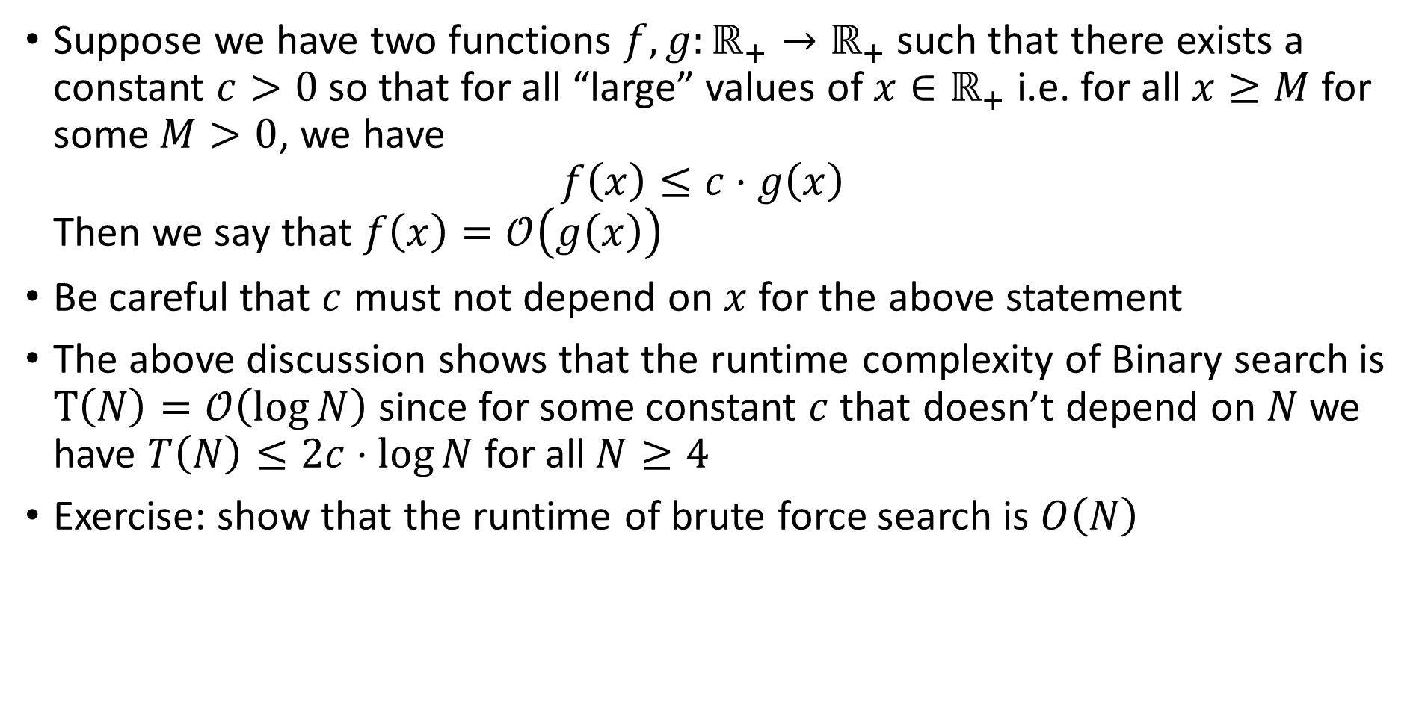
Big-Oh Notation
Suppose we have two functions $f,g:ℝ_{+}→ℝ_{+}$ such that there exists a constant $c>0$ so that for all “large” values of $x∈ℝ_{+}$ i.e. for all $x≥M$ for some $M>0$, we have $f\left(x\right)≤c⋅g\left(x\right)$ Then we say that $f\left(x\right)=𝒪\left(g\left(x\right)\right)$
Be careful that $c$ must not depend on $x$ for the above statement
The above discussion shows that the runtime complexity of Binary search is $T\left(N\right)=𝒪\left(\log{N}\right)$ since for some constant $c$ that doesn’t depend on $N$ we have $T\left(N\right)≤2c⋅\log{N}$ for all $N≥4$
Exercise: show that the runtime of brute force search is $O\left(N\right)$

Slide 12
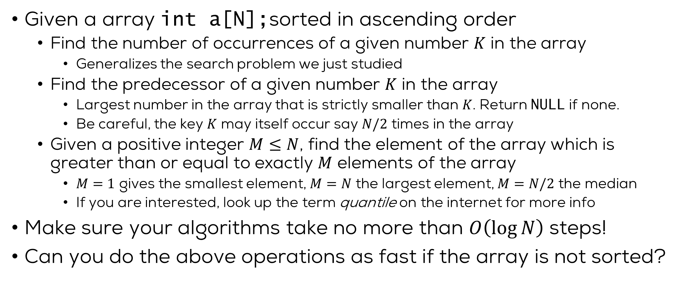
Practice problems
Given a array int a[N];sorted in ascending order
Find the number of occurrences of a given number $K$ in the array
Generalizes the search problem we just studied
Find the predecessor of a given number $K$ in the array
Largest number in the array that is strictly smaller than $K$. Return NULL if none.
Be careful, the key $K$ may itself occur say $N/2$ times in the array
Given a positive integer $M≤N$, find the element of the array which is greater than or equal to exactly $M$ elements of the array
$M=1$ gives the smallest element, $M=N$ the largest element, $M=N/2$ the median
If you are interested, look up the term quantile on the internet for more info
Make sure your algorithms take no more than $O\left(\log{N}\right)$ steps!
Can you do the above operations as fast if the array is not sorted?

Slide 13
Binary search trees
Searching sorted arrays is much faster than unsorted arrays
But sorting arrays itself is an expensive operation
If you keep updating your data between searches, sorting the array over and over may not be optimal
Binary search trees (BSTs) to the rescue:
Each node has two possible children (can be empty)
The left sub-tree of each node must only contain values smaller than the node value
The right sub-tree of each node must only contain values larger than the node value
There should be no duplicate nodes
Left sub-tree for top node

Slide 14
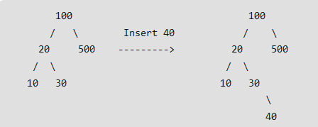
Building a Binary Tree
Given some numbers, we can build a binary tree with each number being at one of the nodes (internal nodes or leaf nodes)
Many ways to build the tree
How we build it depends on how we want to organize the numbers in this tree. But in general
Decide which number will be at the root node, use a structure to store the number and pointers (initially NULL) to left and right subtrees
Send each subsequent number along the left or right branch and add to an existing leaf node

Slide 15
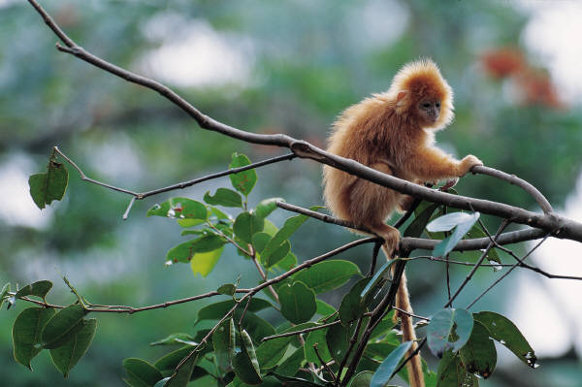
Traversing a Binary Tree
We won’t discuss building the binary tree. Suppose we are given an already built tree
Traversal: Visit each node in the binary tree exactly once
Easy to traverse recursively
Three common ways of visit
inorder: left, root, right
preorder: root, left, right
postorder: left, right, root

Slide 16
Inorder Traversal
root
4
1
7
NULL
-1
3
13
void inorder(tree t)
{
if (t == NULL) return;
inorder(t->left);
printf(“%d ”, t->data);
inorder(t->right);
}
NULL
NULL
NULL
NULL
NULL
NULL
Result
-1
1
3
4
7
13
Notes:
Discuss the efficiency of search, if the data is kept sorted.
A very practical data structure!

Slide 17
Preorder Traversal
root
4
1
7
NULL
void preorder(tree t)
{
if (t == NULL) return;
printf(“%d ”, t->data);
preorder(t->left);
preorder(t->right);
}
-1
3
13
NULL
NULL
NULL
NULL
NULL
NULL
Result
4
1
-1
3
7
13
Notes:
Discuss the efficiency of search, if the data is kept sorted.
A very practical data structure!

Slide 18
Postorder Traversal
root
4
1
7
NULL
-1
3
13
void postorder(tree t)
{
if (t == NULL) return;
postorder(t->left);
postorder(t->right);
printf(“%d “, t->data);
}
NULL
NULL
NULL
NULL
NULL
NULL
Result
-1
3
1
13
7
4
Notes:
Discuss the efficiency of search, if the data is kept sorted.
A very practical data structure!

Slide 19
Binary search vs binary search trees
You will know you’re ready for your programming interview if you can intelligently answer which you’d prefer to use for any given application
Lots of considerations affect the choice: memory caching policy, application resource intensity, etc.
 | Binary search | Binary search tree
Search | O(log N) | O(log N)
Insertion | O(N) | O(log N)
Update | O(1) | O(log N)
Deletion | O(N) | O(log N)

